Slide 1


Sarah Spalding
September 16, 2022

Slide 2

Outline
Executive Summary
Introduction
Methodology
Results
Conclusion
Appendix

Slide 3
Executive Summary
Summary of methodologies
Data Collection
Data Wrangling
Data Visualization
SQL Exploratory Data Analysis
Folium Interactive Map
Plotly Dash Dashboard
Predictive Analysis
Summary of all results
Exploratory Data Analysis Results
Analytics
Predictive Analysis

Slide 4
Introduction
Background:
SpaceX Falcon 9 rocket launches cost 62 million dollars
Other providers cost upwards of 165 million dollars
SpaceX is able to save money by reusing the first stage
Goal:
If we can determine if the first stage will successfully land, we can determine the cost of the launch

Slide 5

Section 1

Slide 6
Methodology
Executive Summary
Data collection methodology:
SpaceX REST API
Web Scrapping Wikipedia
Perform data wrangling
Null values were removed, and one hot encoding was used on categorical variables
Perform exploratory data analysis (EDA) using visualization and SQL
Perform interactive visual analytics using Folium and Plotly Dash
Perform predictive analysis using classification models
Logistic Regression, K Nearest Neighbor, Support Vector Machine, and Decision Tree models were build and evaluated for the best classifier

Slide 7
Data Collection
Space X launch data was collected from the SpaceX REST API
URL: https:// api.spacexdata.com/v4/launches/past
Request JSON from API
Load JSON Response
Save result as Pandas Dataframe
Space X launch data was also collected from the SpaceX Wikipedia page
This was done by webscraping using beautiful soup
Use HTTP get method to request wiki page
Create beautiful soup object from HTML response
Format extracted data into a Pandas Dataframe

Slide 8
Data Collection – SpaceX API
Get response from API
spacex_url = https://api.spacexdata.com/v4/launches/past
response = requests.get(spacex_url)
Apply function to clean data
getBoosterVersion(data)
getLaunchSite(data)
getPayloadData(data)
getCoreData(data)
Assign the lists to a dictionary then dataframe
launch_dict = {'FlightNumber': list(data['flight_number']),'Date': list(data['date']),'BoosterVersion':BoosterVersion,'PayloadMass':PayloadMass,'Orbit':Orbit,'LaunchSite':LaunchSite,'Outcome':Outcome,'Flights':Flights,'GridFins':GridFins,'Reused':Reused,'Legs':Legs,'LandingPad':LandingPad,'Block':Block,'ReusedCount':ReusedCount,'Serial':Serial,'Longitude': Longitude,'Latitude': Latitude}
data = pd.DataFrame.from_dict(launch_dict)
Convert response to a JSON
results = json.loads(response.text)
data = pd.json_normalize(results)
Filter dataframe then export to a csv
data_falcon9.to_csv('dataset_part1.csv', index = False)
https://github.com/sspalding/Data-Science-Labs/blob/2697b9be6a107994db626ce037c033b120bc1a43/Course10_Data%20Science%20Capstone/Course10Lab1_Collecting%20the%20Data.ipynb

Slide 9
Data Collection - Scraping
Get Response from HTML
response = requests.get(static_url).text
Get Column Names
column_names = []
for row in first_launch_table.find_all('th'):
name = extract_column_from_header(row)
if (name != None and len(name)>0):
column_names.append(name)
Append data to keys
Convert dictionary to dataframe
df = pd.DataFrame(launch_dict)
Create beautifulsoup object
soup = BeautifulSoup(response,'html5lib')
Save Dataframe as CSV
df.to_csv('spacex_web_scraped.csv', index = False)
Find Tables
html_tables = soup.find_all('table')
Create Dictionary
launch_dict= dict.fromkeys(column_names)
https://github.com/sspalding/Data-Science-Labs/blob/2697b9be6a107994db626ce037c033b120bc1a43/Course10_Data%20Science%20Capstone/Course10Lab2_Data%20Collection%20and%20Webscraping.ipynb

Slide 10
Data Wrangling
Check Null Values
df.isnull().sum()/df.count()*100
Create a Landing Outcome Label from the Outcomes Column
landing_class = []
for elem in df['Outcome']:
if elem in bad_outcomes:
landing_class.append(0)
else:
landing_class.append(1)
df['Class']=landing_class
Calculate the Occurrence of Mission Outcome Per Orbit Type
landing_outcomes = df['Outcome'].value_counts()
Calculate the Number of Launches from Each Site
df['LaunchSite'].value_counts()
Calculate the Occurrence of Each Orbit
df['Orbit'].value_counts()
Save to CSV
df.to_csv('dataset_part2.csv', index = False)
https://github.com/sspalding/Data-Science-Labs/blob/2697b9be6a107994db626ce037c033b120bc1a43/Course10_Data%20Science%20Capstone/Course10Lab3_DataWrangling.ipynb

Slide 11
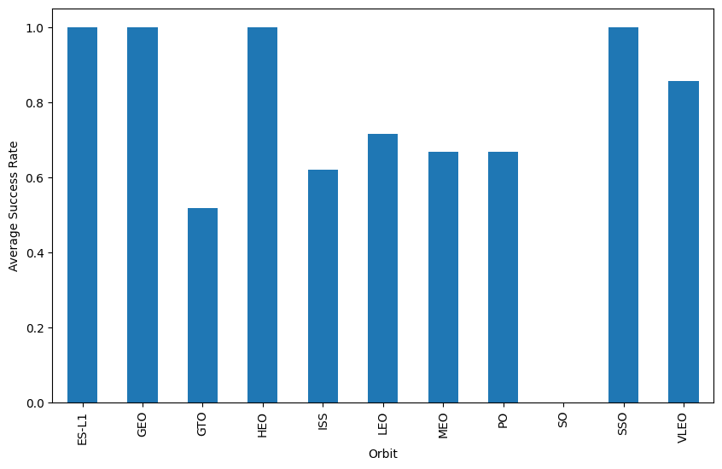
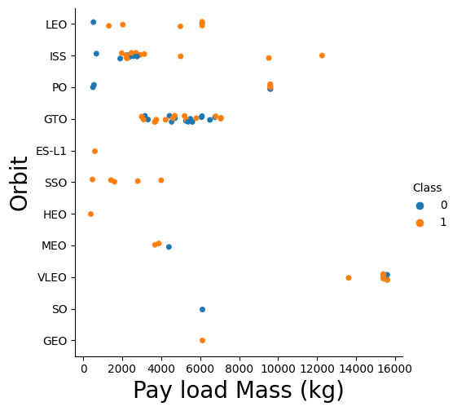
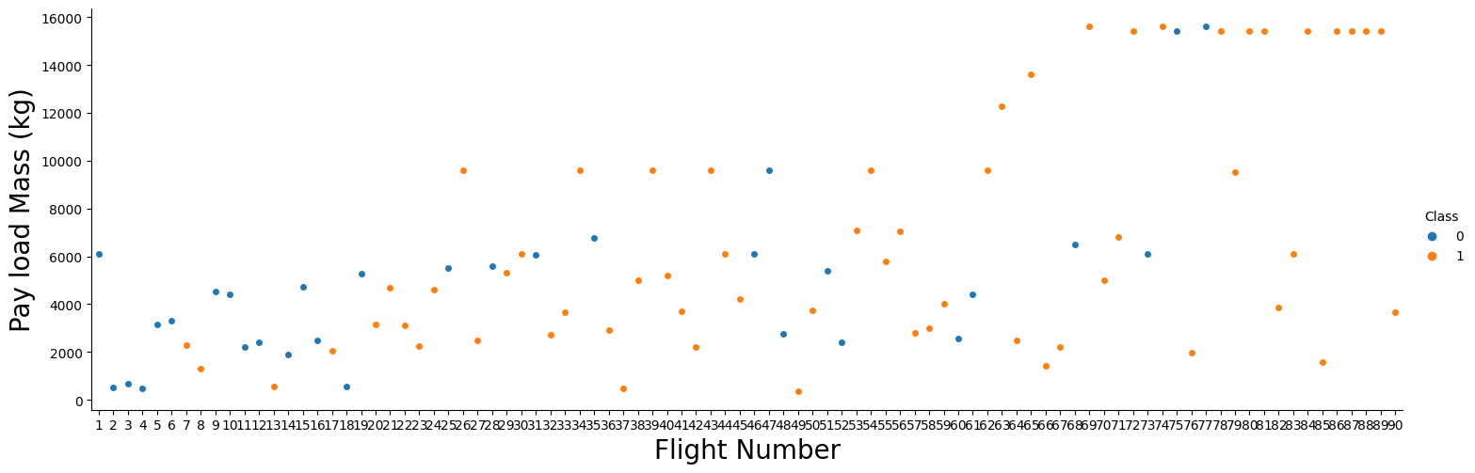
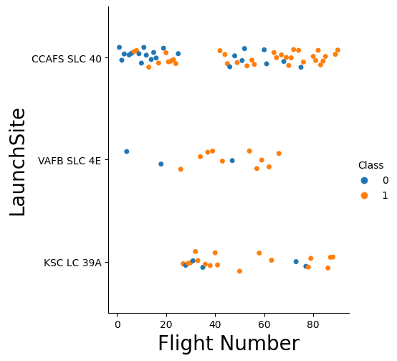
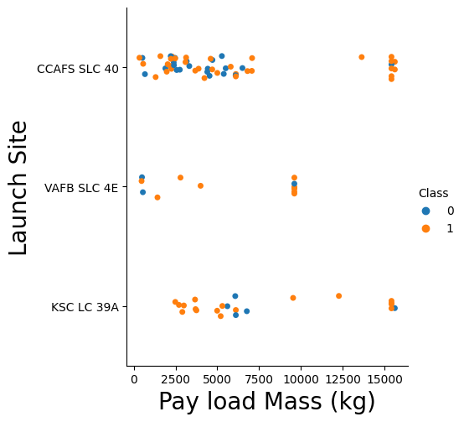
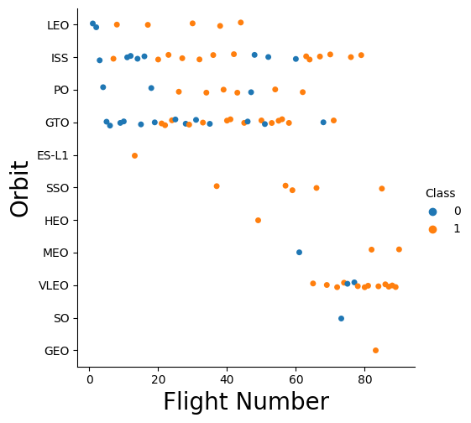
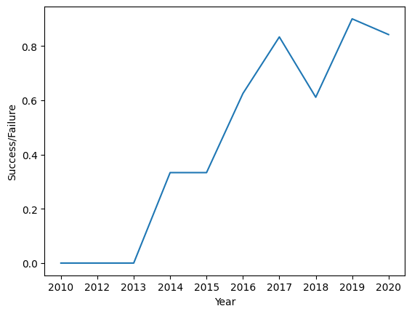
EDA with Data Visualization
The plots shown below were used to identify which conditions had any correlation to the success of the stage 1 booster landing
https://github.com/sspalding/Data-Science-Labs/blob/2697b9be6a107994db626ce037c033b120bc1a43/Course10_Data%20Science%20Capstone/Course10Lab5_Exploring%20and%20Preparing%20Data.ipynb

Slide 12
EDA with SQL
SQL Queries Performed:
Display the names of the unique launch sites in the space mission
Display 5 records where launch sites begin with the string 'CCA’
Display the total payload mass carried by boosters launched by NASA (CRS)
Display the average payload mass carried by booster version F9 v1.1
List the date when the first successful landing outcome in ground pad was achieved
List the names of the boosters which have success in drone ship and have payload mass greater than 4000 but less than 6000
List the total number of successful and failure mission outcomes
List the names of the booster_versions which have carried the maximum payload mass, use a subquery
List the records which will display the month names, failure landing_outcomes in drone ship , booster versions, launch_site for the months in year 2015.
https://gitLub.com/sspalding/Data-Science-Labs/blob/2697b9be6a107994db626ce037c033b120bc1a43/Course10_Data%20Science%20Capstone/Course10Lab4_Exploratory%20Data%20Analysis.ipynb

Slide 13
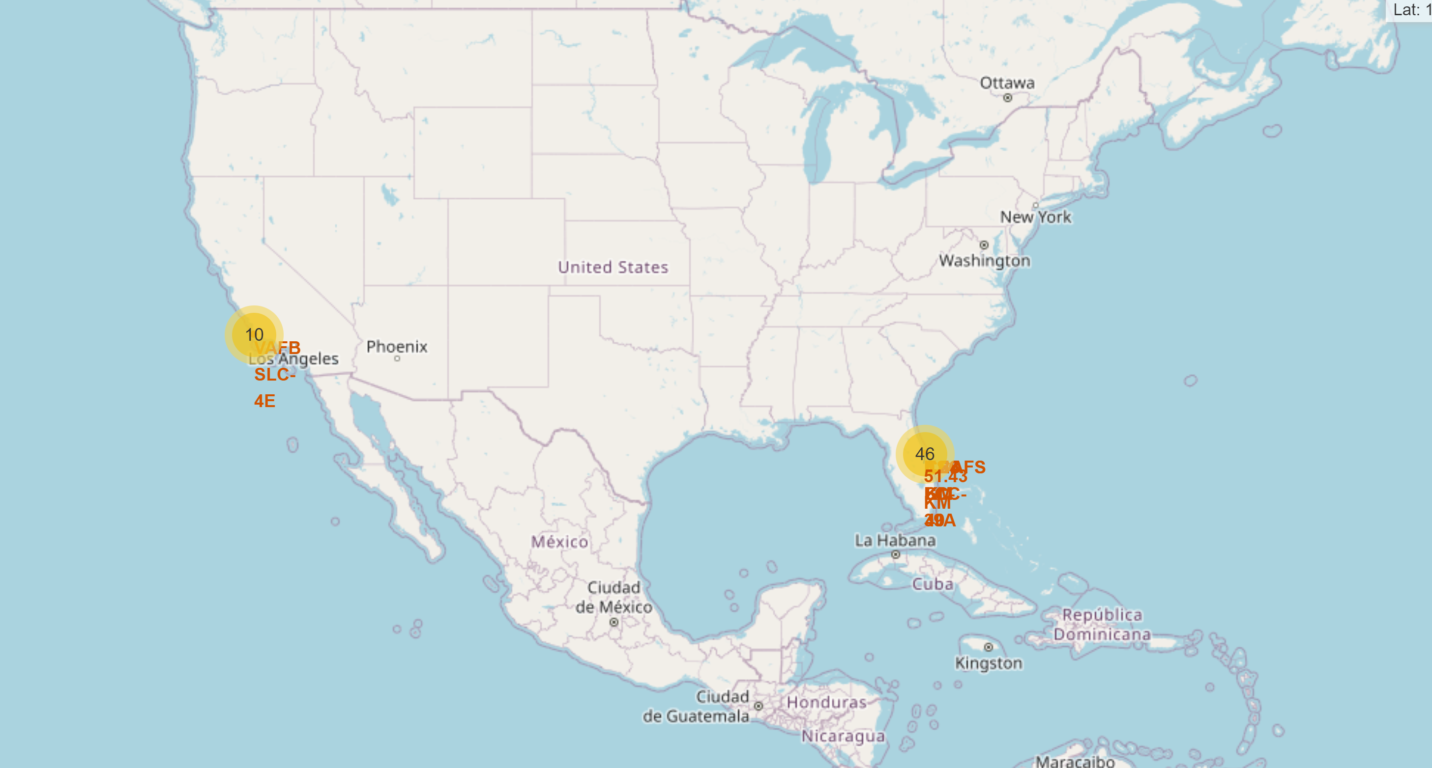
Build an Interactive Map with Folium
Map markers were added to the map with the goal of finding the launch site with the highest booster landing
Marker Clusters were added to group the launches from specific sites to make the map less crowded
A polyline between the launch site and the nearest coastline, city, railway and highway were added
https://github.com/sspalding/Data-Science-Labs/blob/72c0218c3c57cbdb7883c62a5056df6f3f1a2837/Course10_Data%20Science%20Capstone/Course10Lab6_Location%20Analysis%20with%20Folium.ipynb

Slide 14
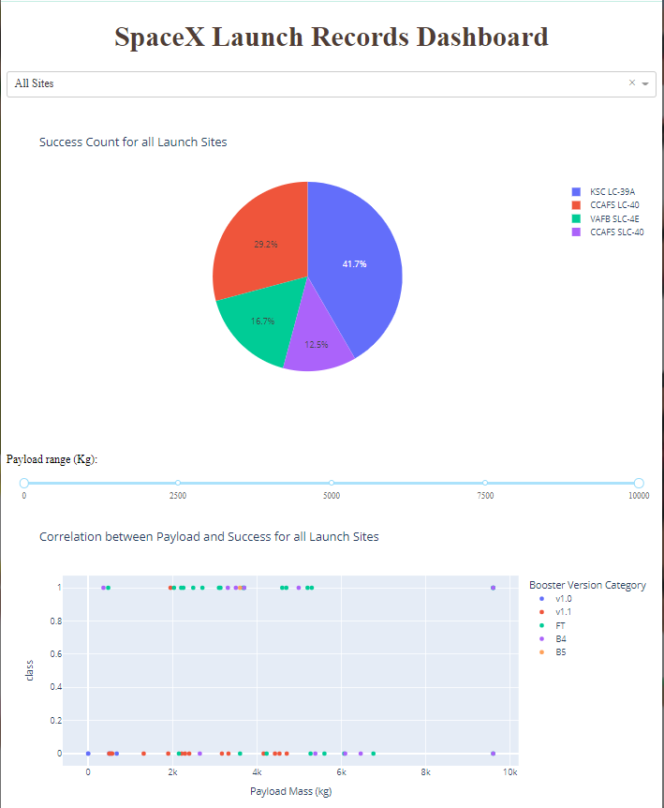
Build a Dashboard with Plotly Dash
A drop-down menu was added to the dashboard to allow users to choose the launch site(s) they wish to see daya on
An interactive pie chart was added to show users the total successful launch count for their selection from the drop-down menu
A slider was added to allow users to choose the payload size
A scatter plot was added to show users the correlation between their chosen payload and launch success for different sites
https://github.com/sspalding/Data-Science-Labs/blob/72c0218c3c57cbdb7883c62a5056df6f3f1a2837/Course10_Data%20Science%20Capstone/Course10Lab7_Dashboard%20Application%20with%20Plotly%20Dash.py

Slide 15
Predictive Analysis (Classification)
The below process was performed for Logistic Regression, Support Vector Machine, Decision Tree, and K Nearest Neighbors machine learning models
The accuracy of the model was compared to determine which was the best
Load the Data
Split the data into training and testing sets
Fit the object to find the parameters
Assign data to X and Y variables
Create machine learning model object
Calculate the model accuracy
Create parameters for machine learning model
Standardize the data in the X variable
Create a grid search cv object
View the confusion matrix
https://github.com/sspalding/Data-Science-Labs/blob/72c0218c3c57cbdb7883c62a5056df6f3f1a2837/Course10_Data%20Science%20Capstone/Course10Lab7_Machine%20Learning.ipynb

Slide 16
Results
The success rate of booster landings is correlated to the year, it is predicted that as time goes on their will be less unsuccessful launches
The launch site with the highest success rate was KSC LC 39A
The orbits ES L1, GEO, HEO, and SSO had the highest success rates
Lower weighted payloads had more successful booser landings then higher weighted payloads
All four machine learning models performed the same in terms of prediction accuracy

Slide 17

Section 2

Slide 18
Flight Number vs. Launch Site
Launch site CCAFS SLC 40 had the most launches

Slide 19
Payload vs. Launch Site
Launch site VAFB SLC 4E had the payloads with the lowest weight

Slide 20
Success Rate vs. Orbit Type
The launches going to orbits ES L1, GEO, HEO, and SSO had the highest booster landing success rate
The launches going to orbit SO had the lowest booster landing success rate

Slide 21
Flight Number vs. Orbit Type
Recently, more launches have been going to the VLEO orbit

Slide 22
Payload vs. Orbit Type
Most payloads going to the ISS weigh between 2000 and 4000 kg
Most payloads going to the GTO orbit weigh between 2000 and 8000 kg

Slide 23
Launch Success Yearly Trend
The success rate has been generally increasing over the years

Slide 24
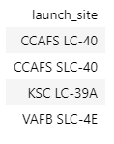
All Launch Site Names
The launch site names were queried using the following code
%sql select unique(LAUNCH_SITE) from SPACEXTBL;

Slide 25
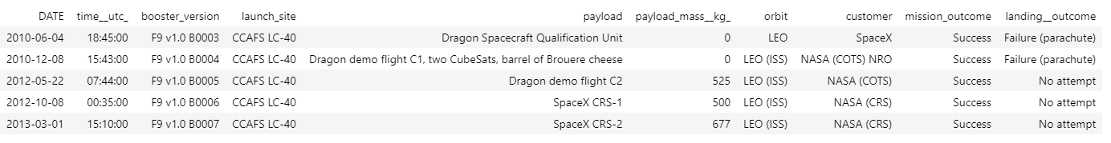
Launch Site Names Begin with 'CCA'
The 5 records where launch sites begin with `CCA` were found using the following query
%sql select * from SPACEXTBL where LAUNCH_SITE like 'CCA%' limit 5;

Slide 26
Total Payload Mass
The total payload carried by boosters from NASA was 45,596
It was found using the following query
%sql select sum(PAYLOAD_MASS__KG_) from SPACEXTBL where "customer" = 'NASA (CRS)';

Slide 27
Average Payload Mass by F9 v1.1
The average payload mass carried by booster version F9 v1.1 was 2,928
It was found using the following query
%sql select avg(PAYLOAD_MASS__KG_) from SPACEXTBL where BOOSTER_VERSION = 'F9 v1.1';

Slide 28
First Successful Ground Landing Date
The date of the first successful landing outcome on ground pad was 2015-12-22
The following query was used to find it
%sql select min(DATE) from SPACEXTBL where LANDING__OUTCOME = 'Success (ground pad)';

Slide 29
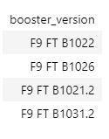
Successful Drone Ship Landing with Payload between 4000 and 6000
The names of boosters which have successfully landed on drone ship and had payload mass greater than 4000 but less than 6000 were found by the following query
%sql select BOOSTER_VERSION from SPACEXTBL where LANDING__OUTCOME = 'Success (drone ship)' and PAYLOAD_MASS__KG_ between 4000 and 6000;

Slide 30
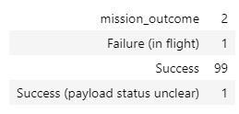
Total Number of Successful and Failure Mission Outcomes
The total number of successful and failure mission outcomes was found using the following query
%sql select MISSION_OUTCOME, count(MISSION_OUTCOME) from SPACEXTBL group by MISSION_OUTCOME;

Slide 31
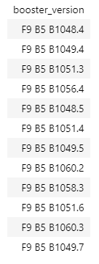
Boosters Carried Maximum Payload
The names of the booster which have carried the maximum payload mass was found using the following query
%sql select BOOSTER_VERSION from SPACEXTBL where PAYLOAD_MASS__KG_ = (select max(PAYLOAD_MASS__KG_) from SPACEXTBL);

Slide 32
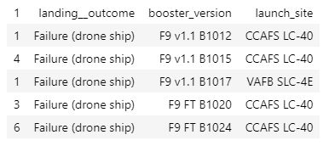
2015 Launch Records
The failed landing_outcomes in drone ship, their booster versions, and launch site names for in year 2015 were found using the following query
%sql select MONTH(DATE), LANDING__OUTCOME, BOOSTER_VERSION, LAUNCH_SITE from SPACEXTBL where EXTRACT(YEAR FROM DATE) and LANDING__OUTCOME = 'Failure (drone ship)';

Slide 33
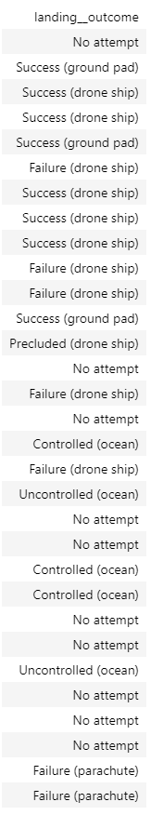
Rank Landing Outcomes Between 2010-06-04 and 2017-03-20
The ranked count of landing outcomes (such as Failure (drone ship) or Success (ground pad)) between the date 2010-06-04 and 2017-03-20, in descending order were found using the following query
%sql select LANDING__OUTCOME from SPACEXTBL where DATE between '2010-06-04' and '2017-03-20' order by DATE desc;

Slide 34

Section 3

Slide 35
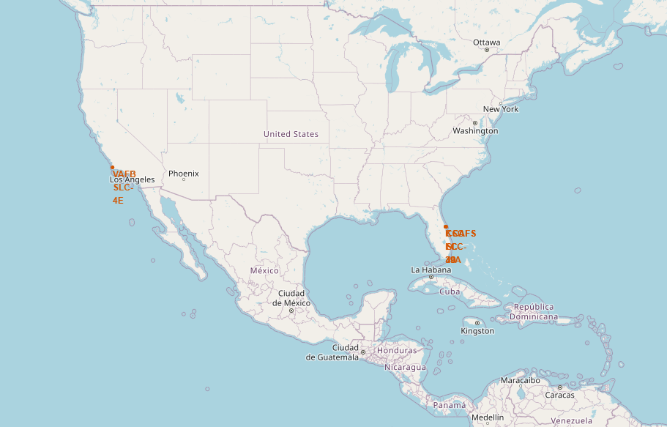
All Launch Site Locations
Four launch sites are shown on the map:
CCAFS LC-40
CCAFS SLC-40
KSC LC-39A
VAFB SLC-4E

Slide 36
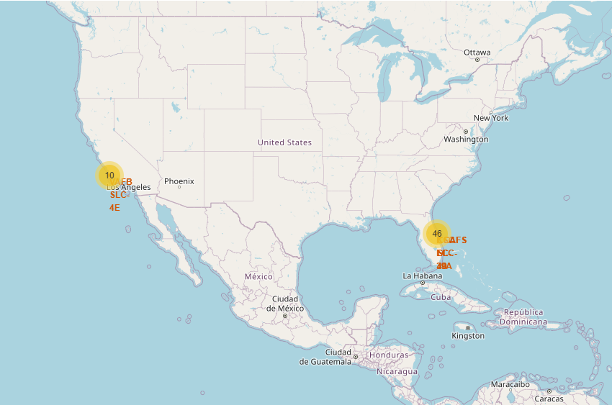
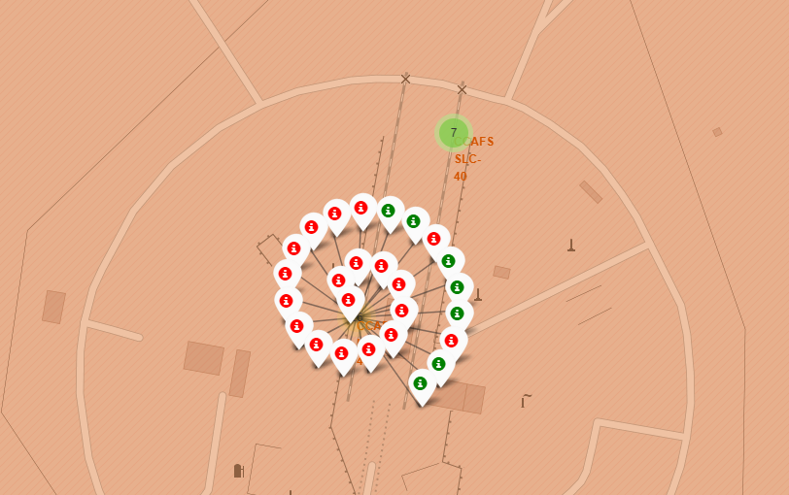
Mapped Launch Outcomes
The launch success rate was added to the map as color, where green was successful, and red was failure

Slide 37
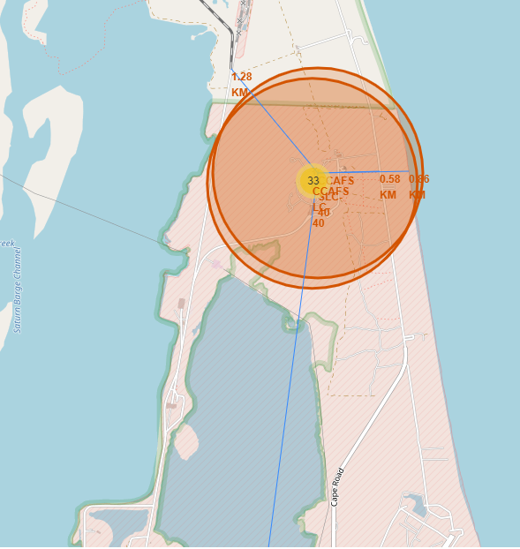
Launch Site Map with Proximities to Railways, Highways and Coastlines
The blue line is the proximity line to the locations of interest

Slide 38

Section 4

Slide 39
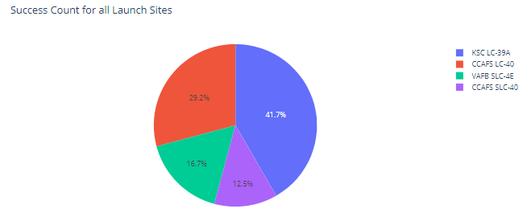
Pie Chart of Success Counts for all Launch Sites
Hovering over a slice of the pie chart will display more information about that slice

Slide 40
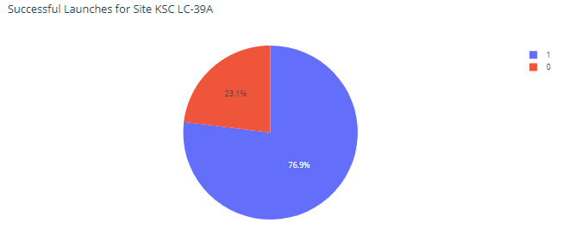
Pie Chart of Successful Launches from KSC LC-39A
KSC LC-39A had the highest success rate of all the launch sites
1 indicates a success, 0 indicates a failure

Slide 41
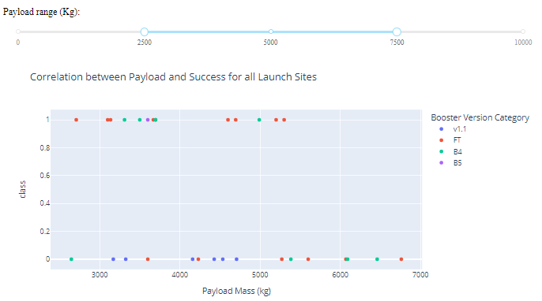
Payload vs Launch Outcome for all sites
Adjusting the payload range slider changes what is displayed in the scatter plot
This chart show a range of 2500 to 7500 kg
Hovering over individual data points displays more information about that data point

Slide 42

Section 5

Slide 43
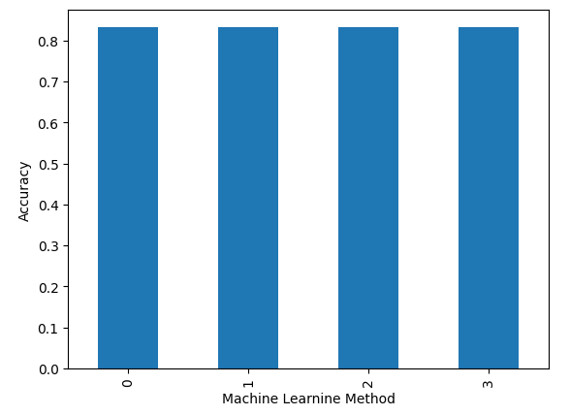
Classification Accuracy
All models had the same accuracy of 83.3%

Slide 44
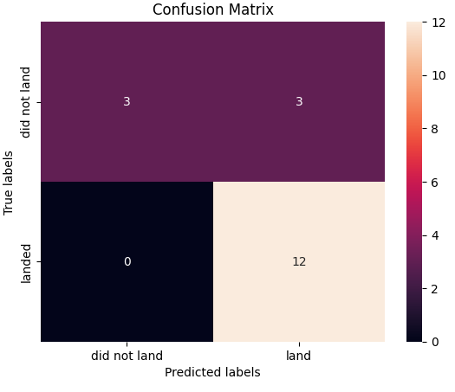
Confusion Matrix
All models had the same confusion matrix
The confusion matrix shows there were 3 true positives, 3 false negatives, 0 false positives, and 12 true positives

Slide 45
Conclusions
All four machine learning models performed the same in terms of prediction accuracy
The conditions to get the highest likelihood of a successful booster landing are:
Launch from KSC LC 39A
Have a lower weighted payload
Go to the GEO, HEO, SSO, or ES L1 Orbit
Over time the success rate has increased and will most likely continue to do so

Slide 46


